Slide 1
Unconstrained Optimization
TexPoint fonts used in EMF.
Read the TexPoint manual before you delete this box.: AAAAAAAAA

Slide 2
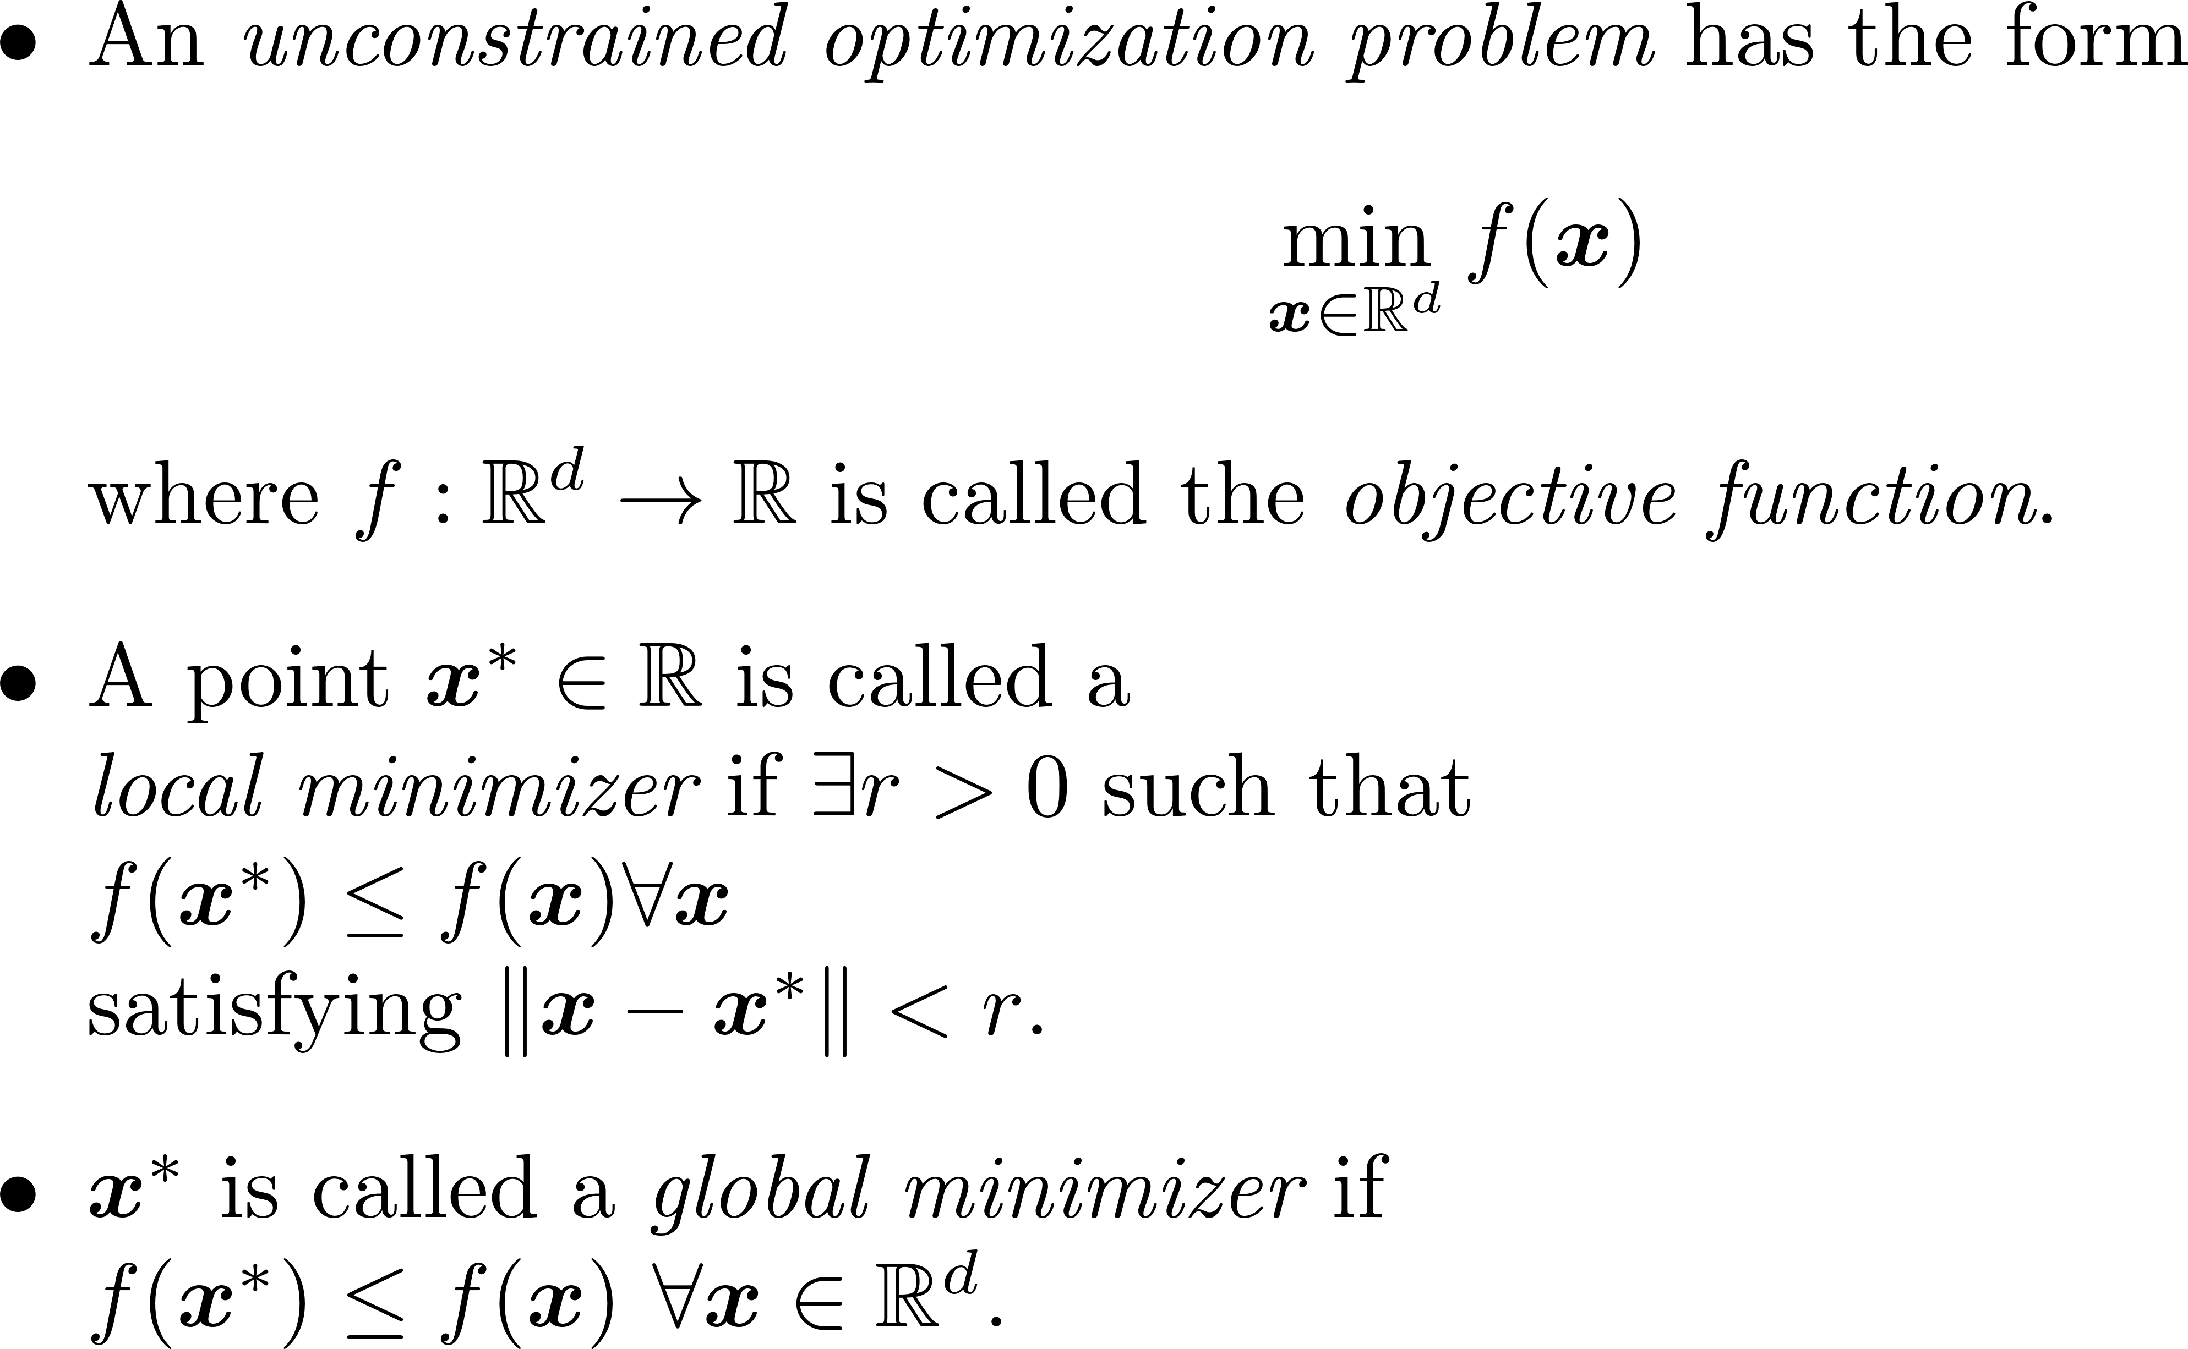
Unconstrained Optimization

Slide 3
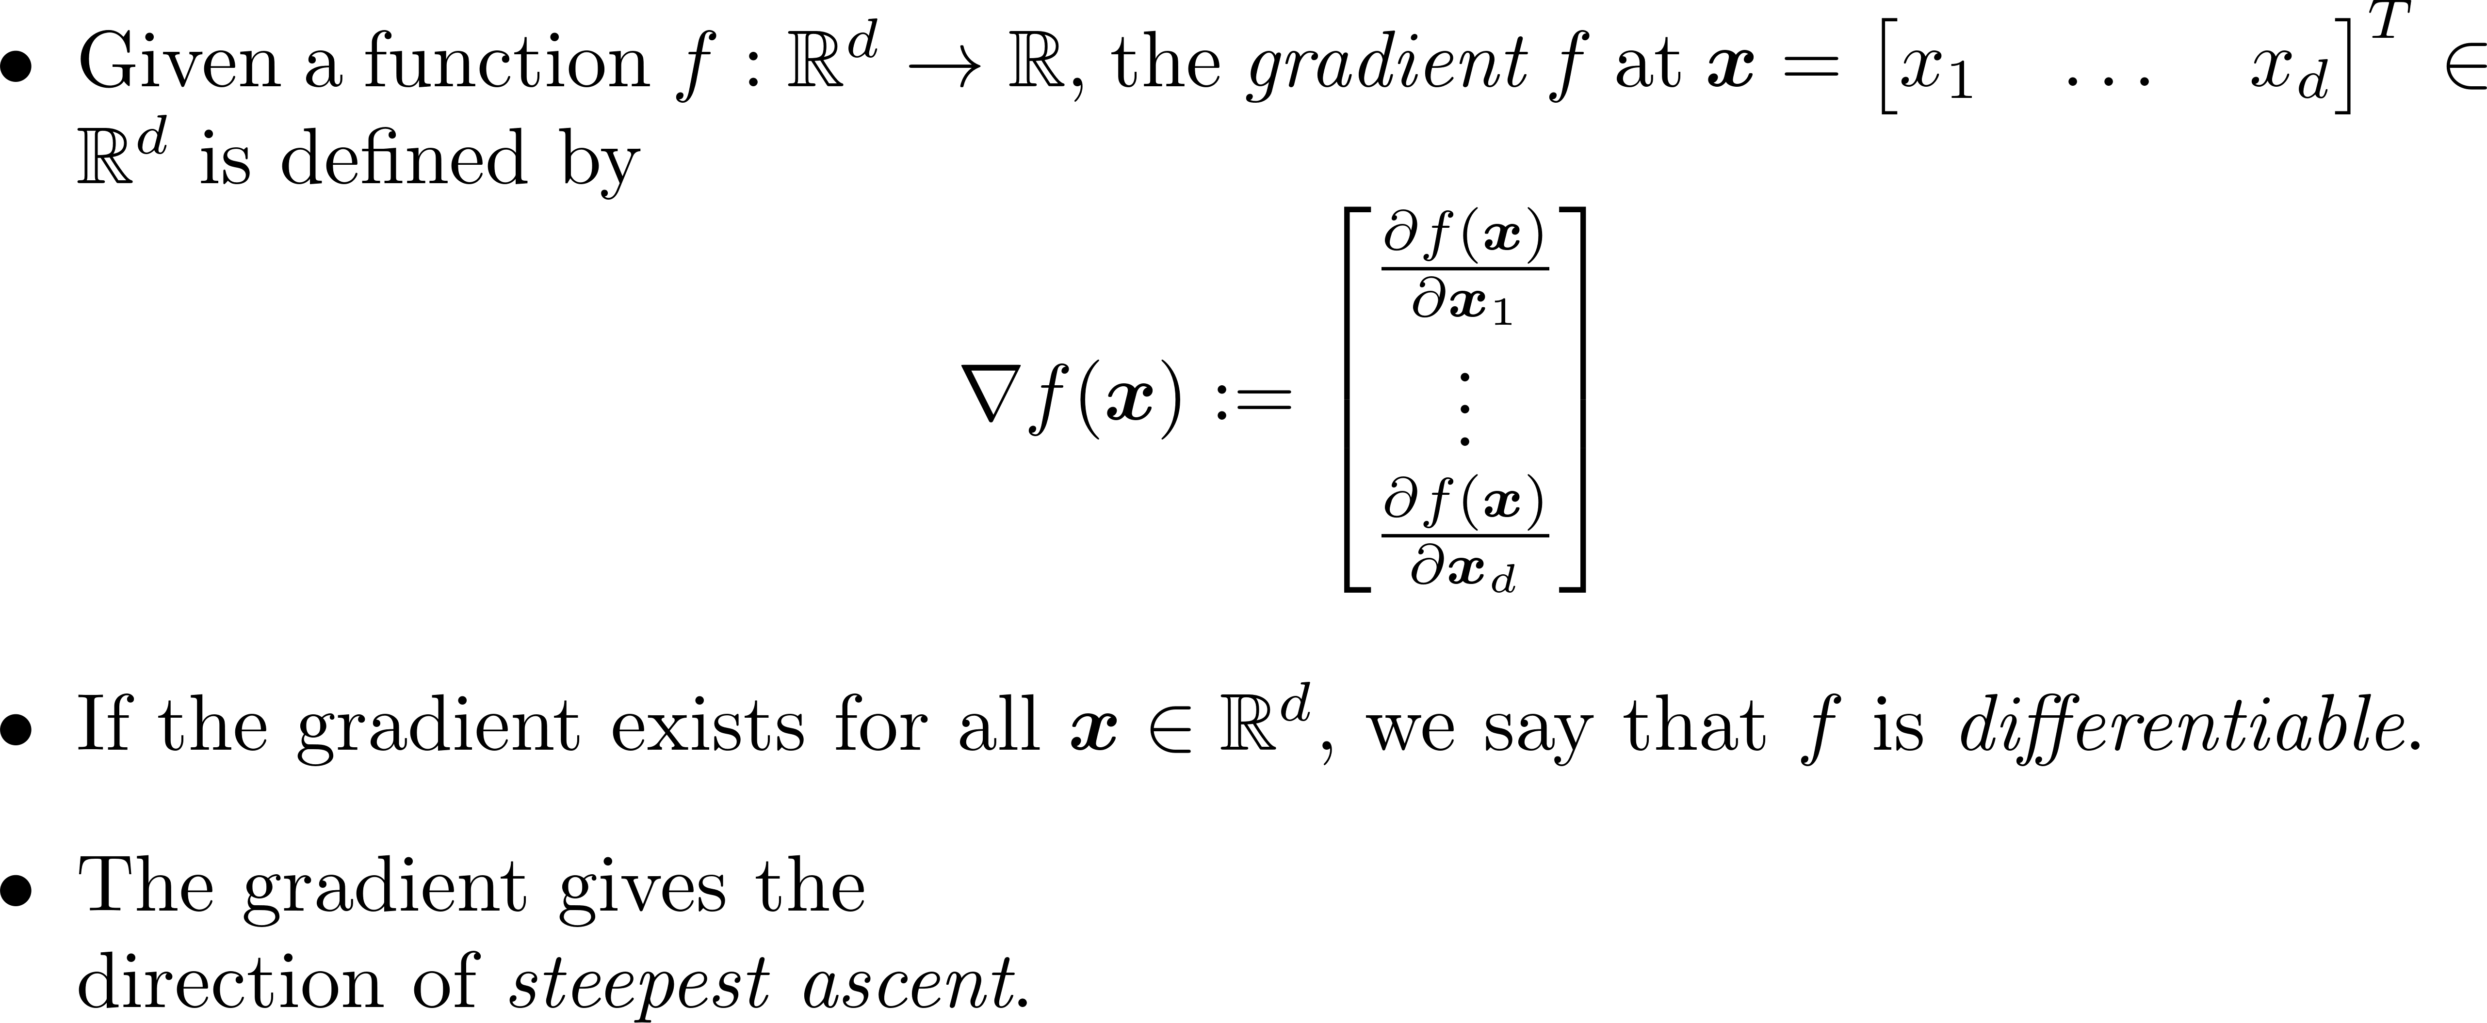
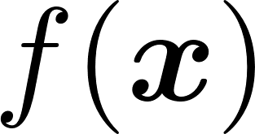
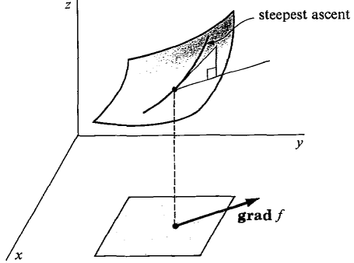
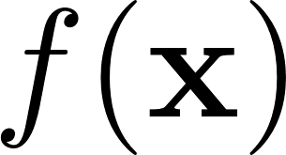
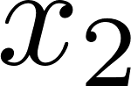


Gradient

Slide 4
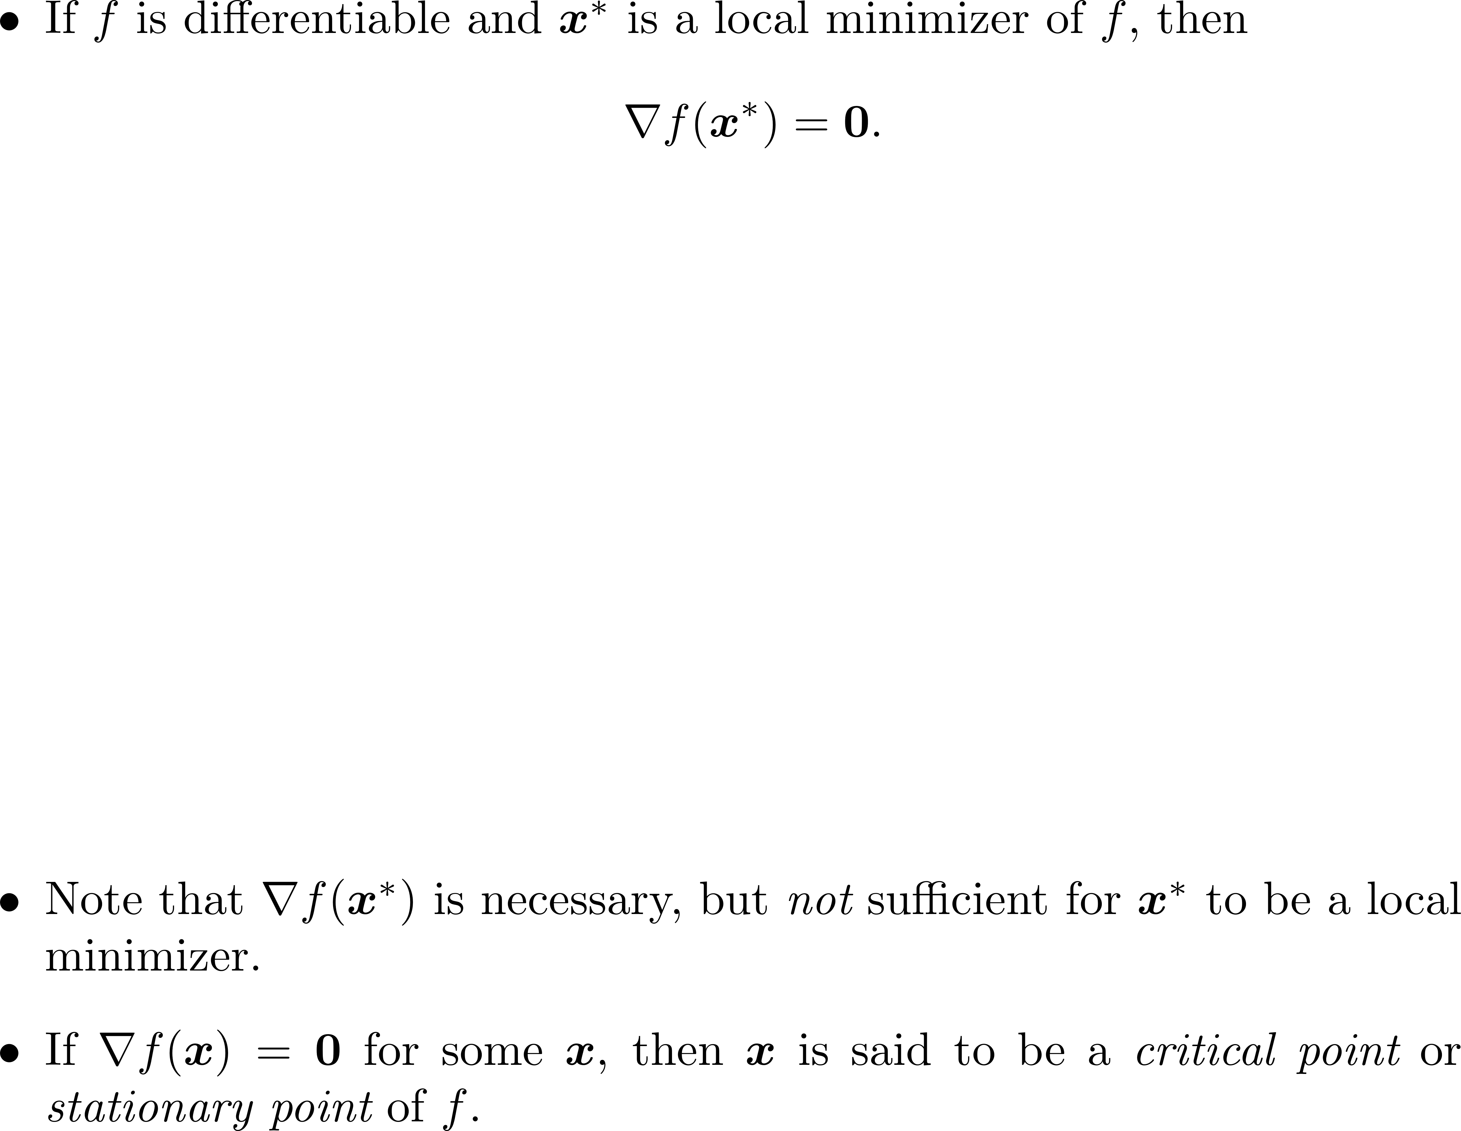
First Order Necessary Condition

Slide 5
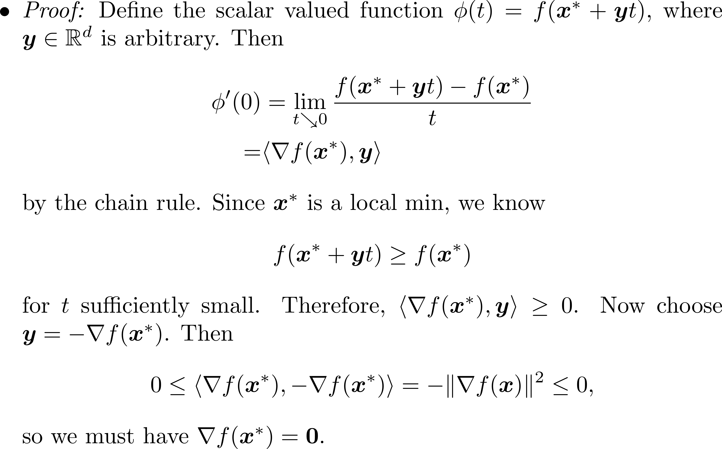
First Order Necessary Condition

Slide 6
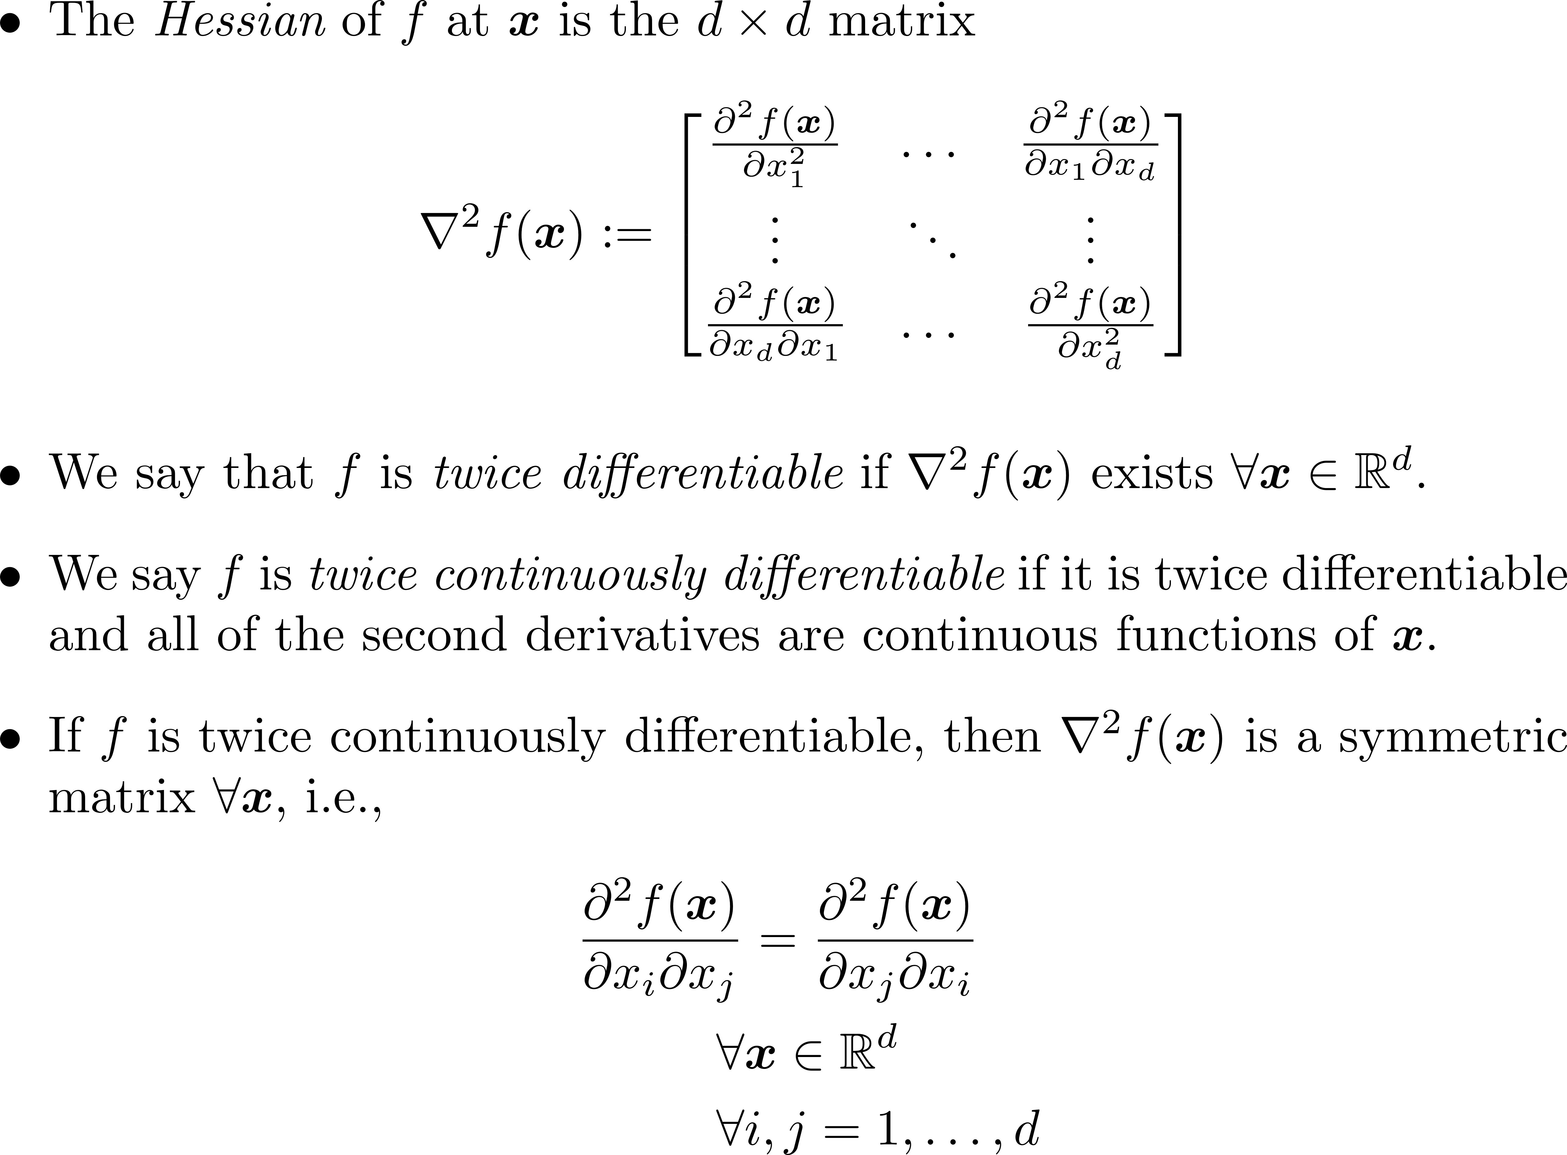
Hessian

Slide 7
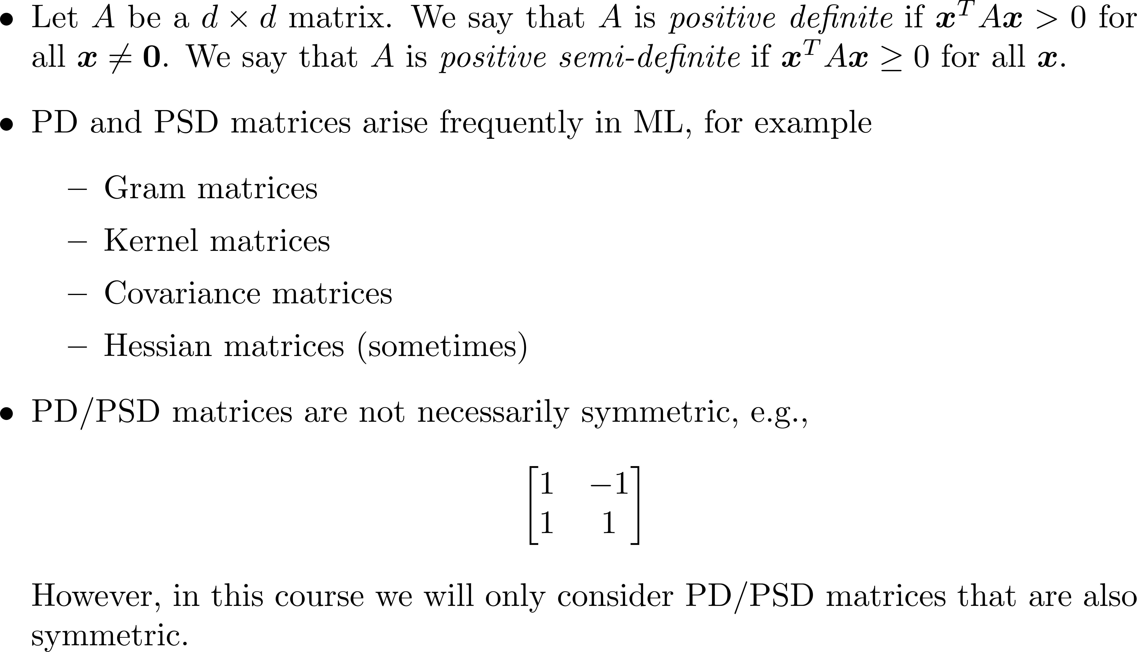
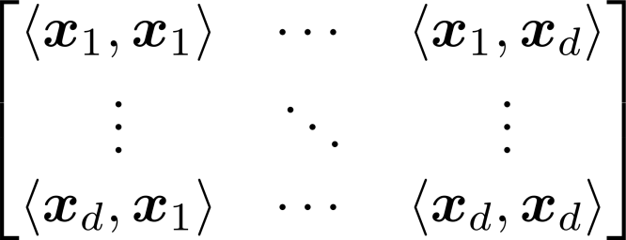
Positive (Semi-)Definite Matrices

Slide 8
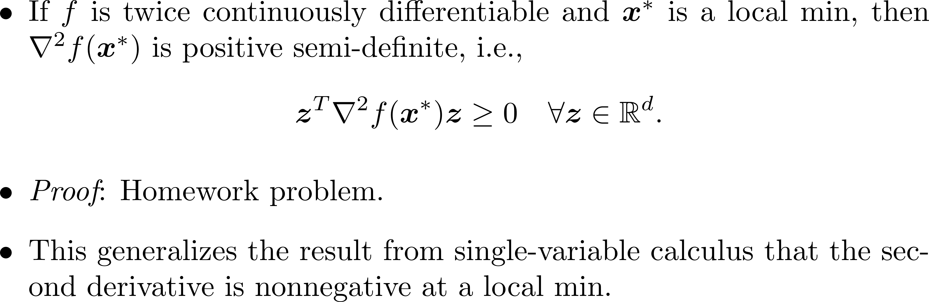
Second Order Necessary Condition

Slide 9
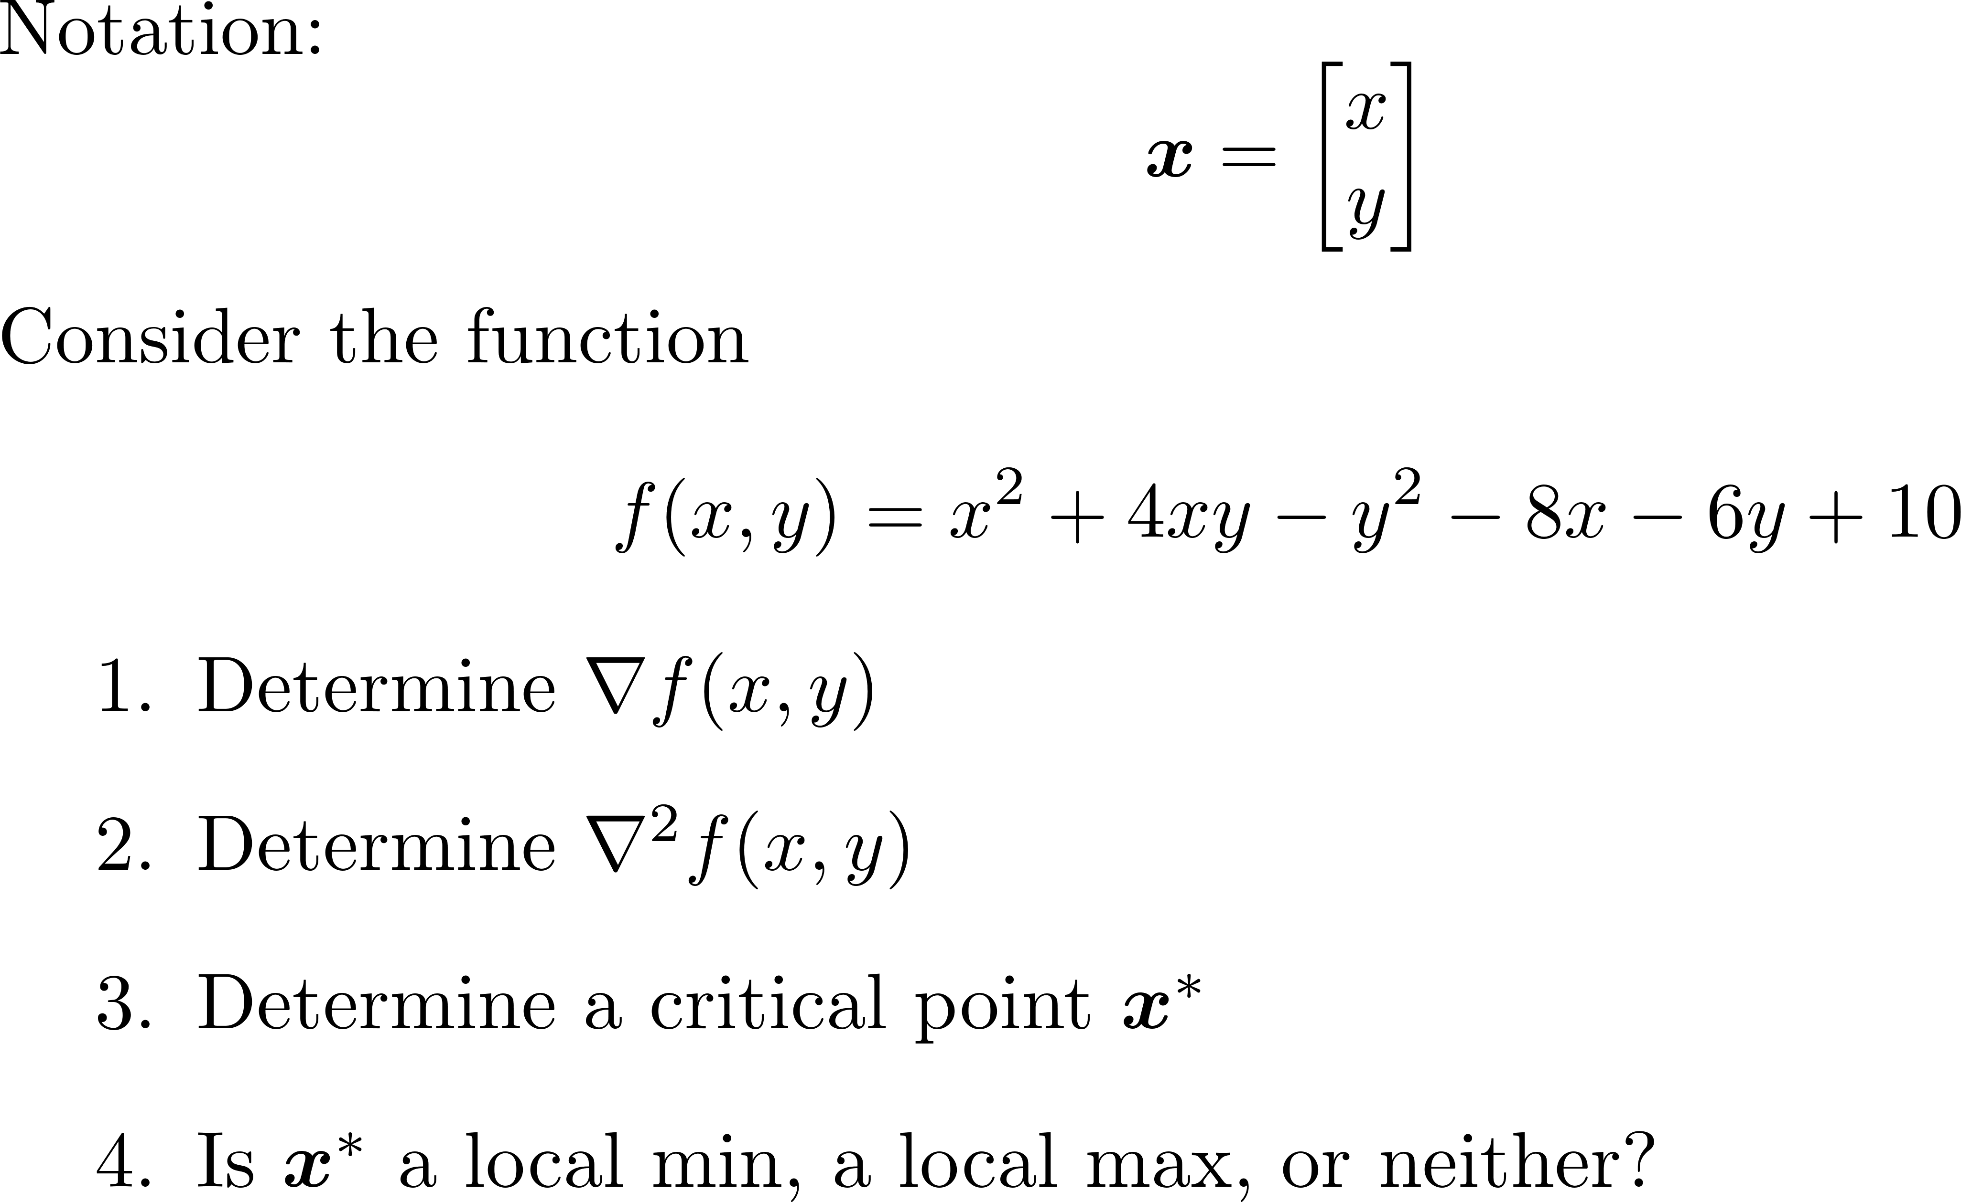
Group Exercise

Slide 10
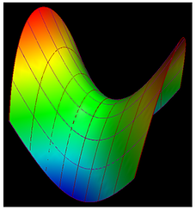
Group Exercise - Solution

Slide 11
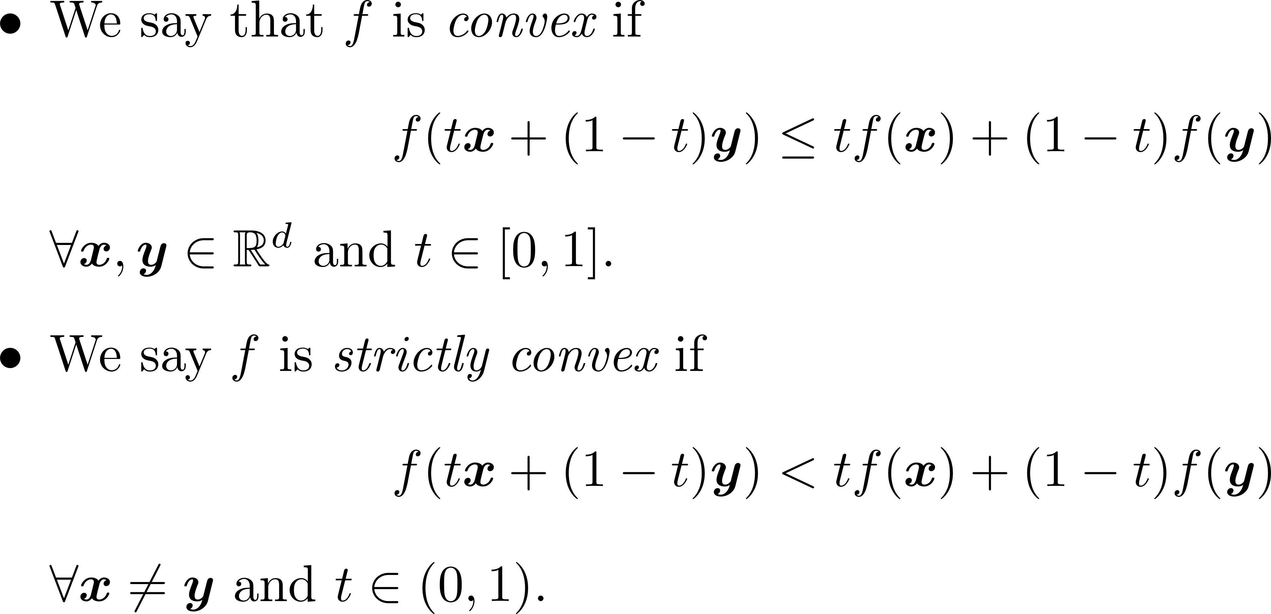
Convexity

Slide 12
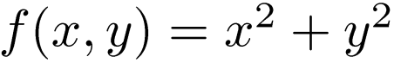
Convexity
TexPoint fonts used in EMF.
Read the TexPoint manual before you delete this box.: AAAAAAAAA

Slide 13
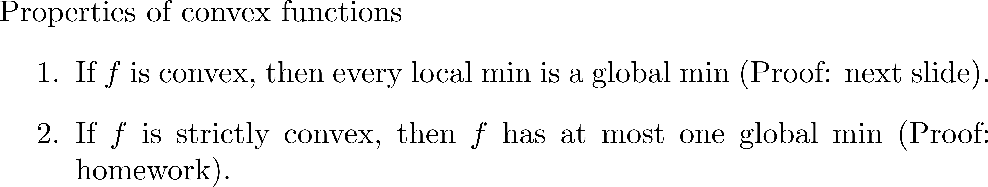
Convex Functions are Nice

Slide 14
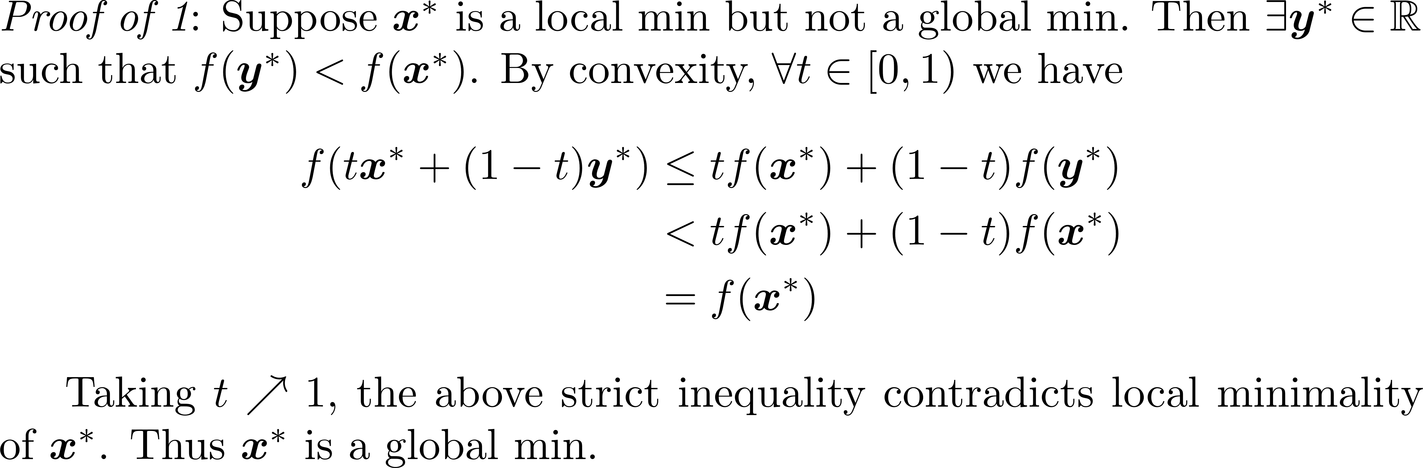
Convex Functions are Nice

Slide 15
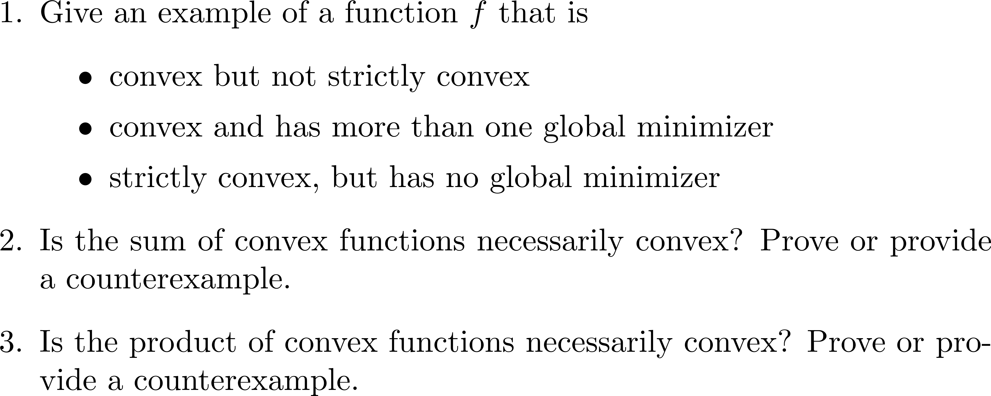
Group Exercise

Slide 16
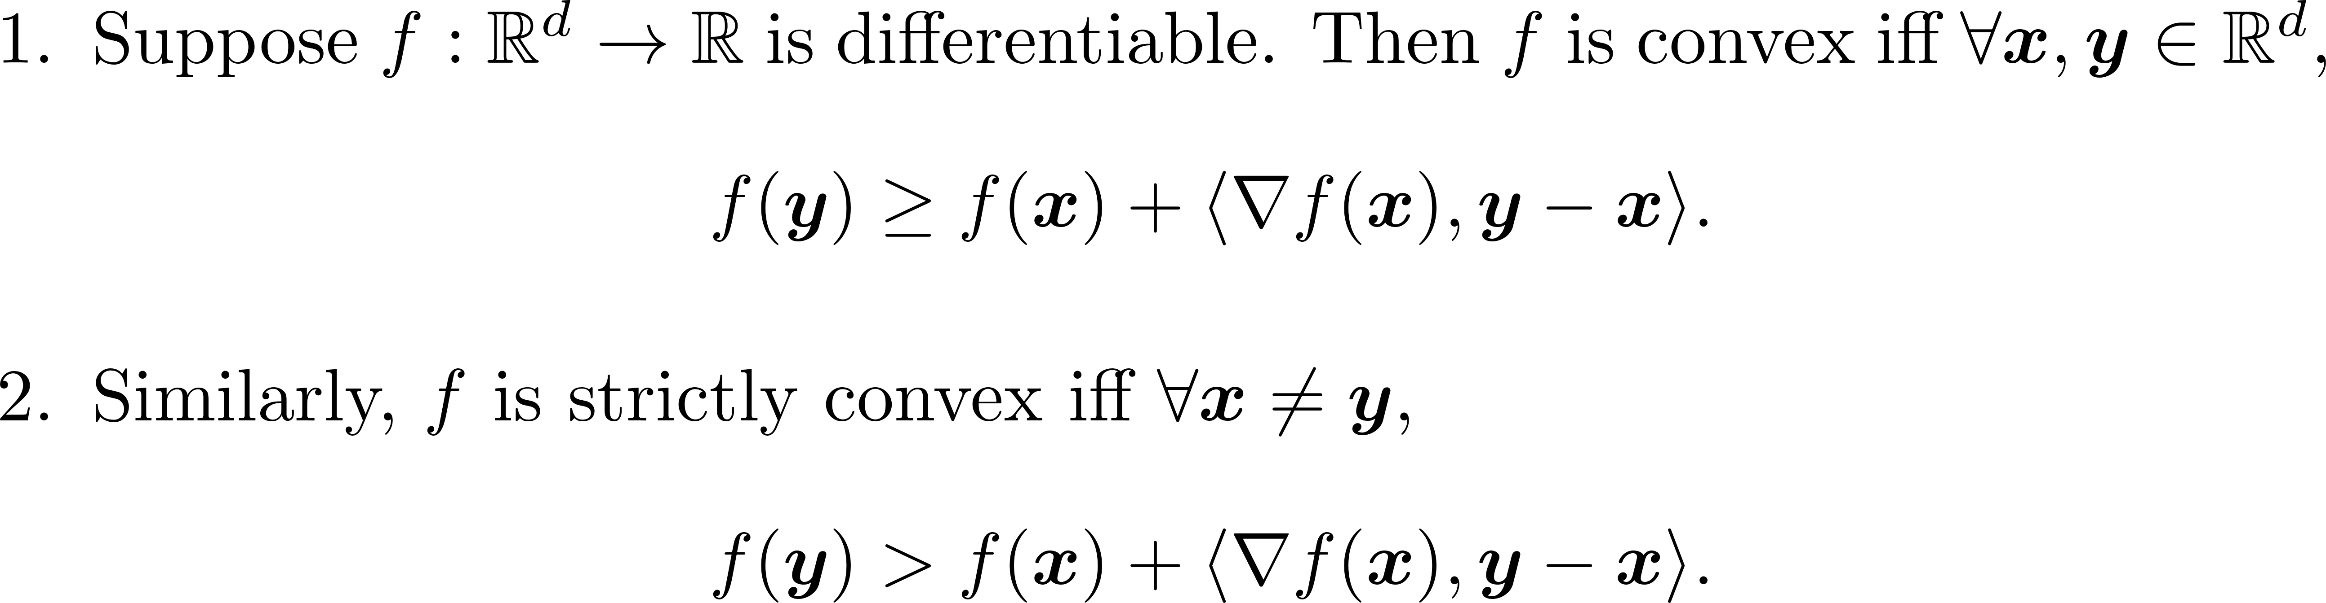
1st Order Characterization of Convexity

Slide 17
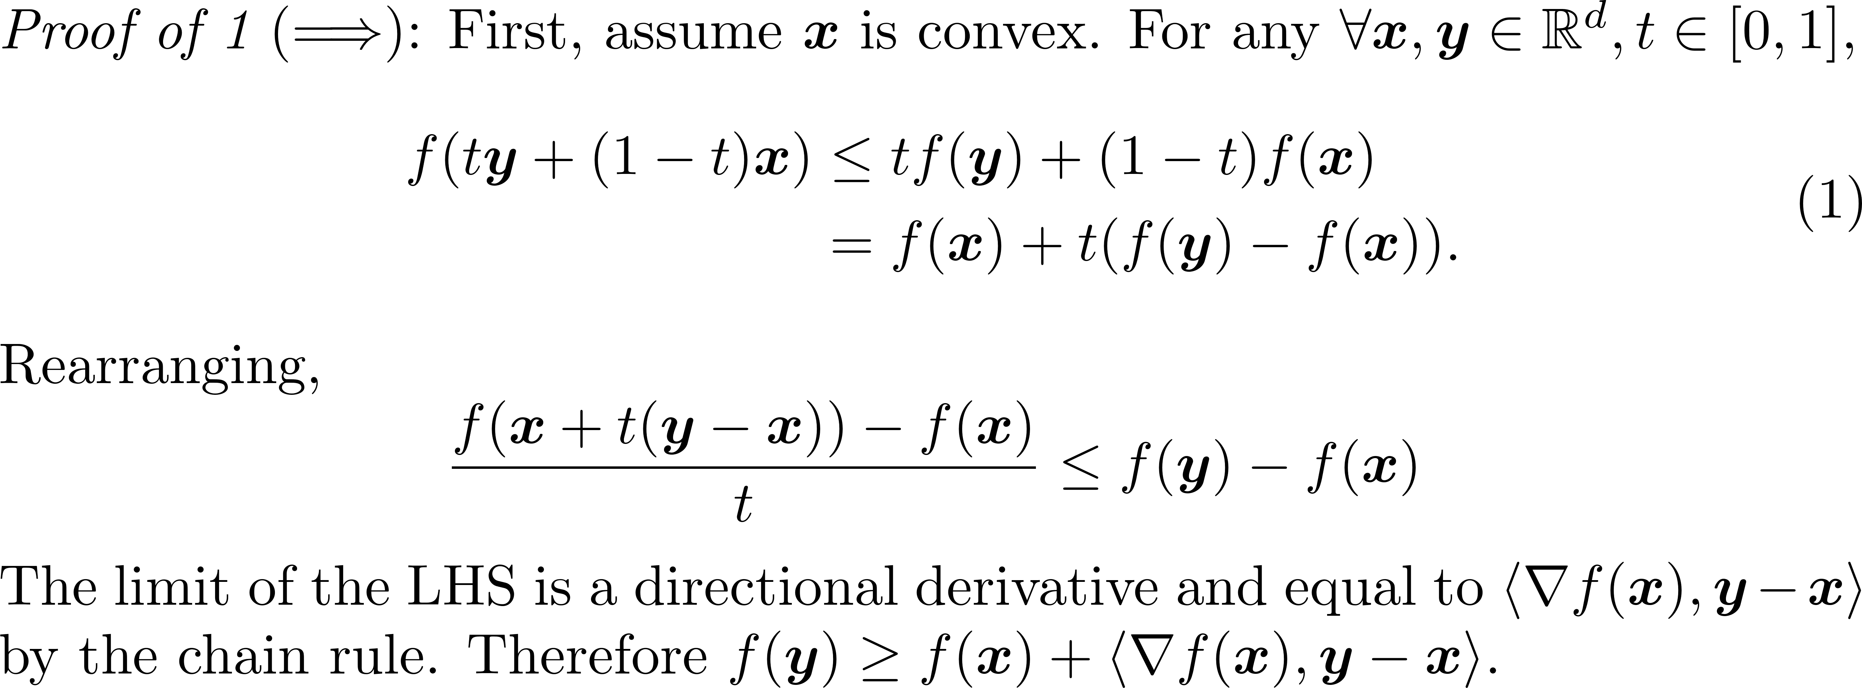
1st Order Characterization of Convexity

Slide 18
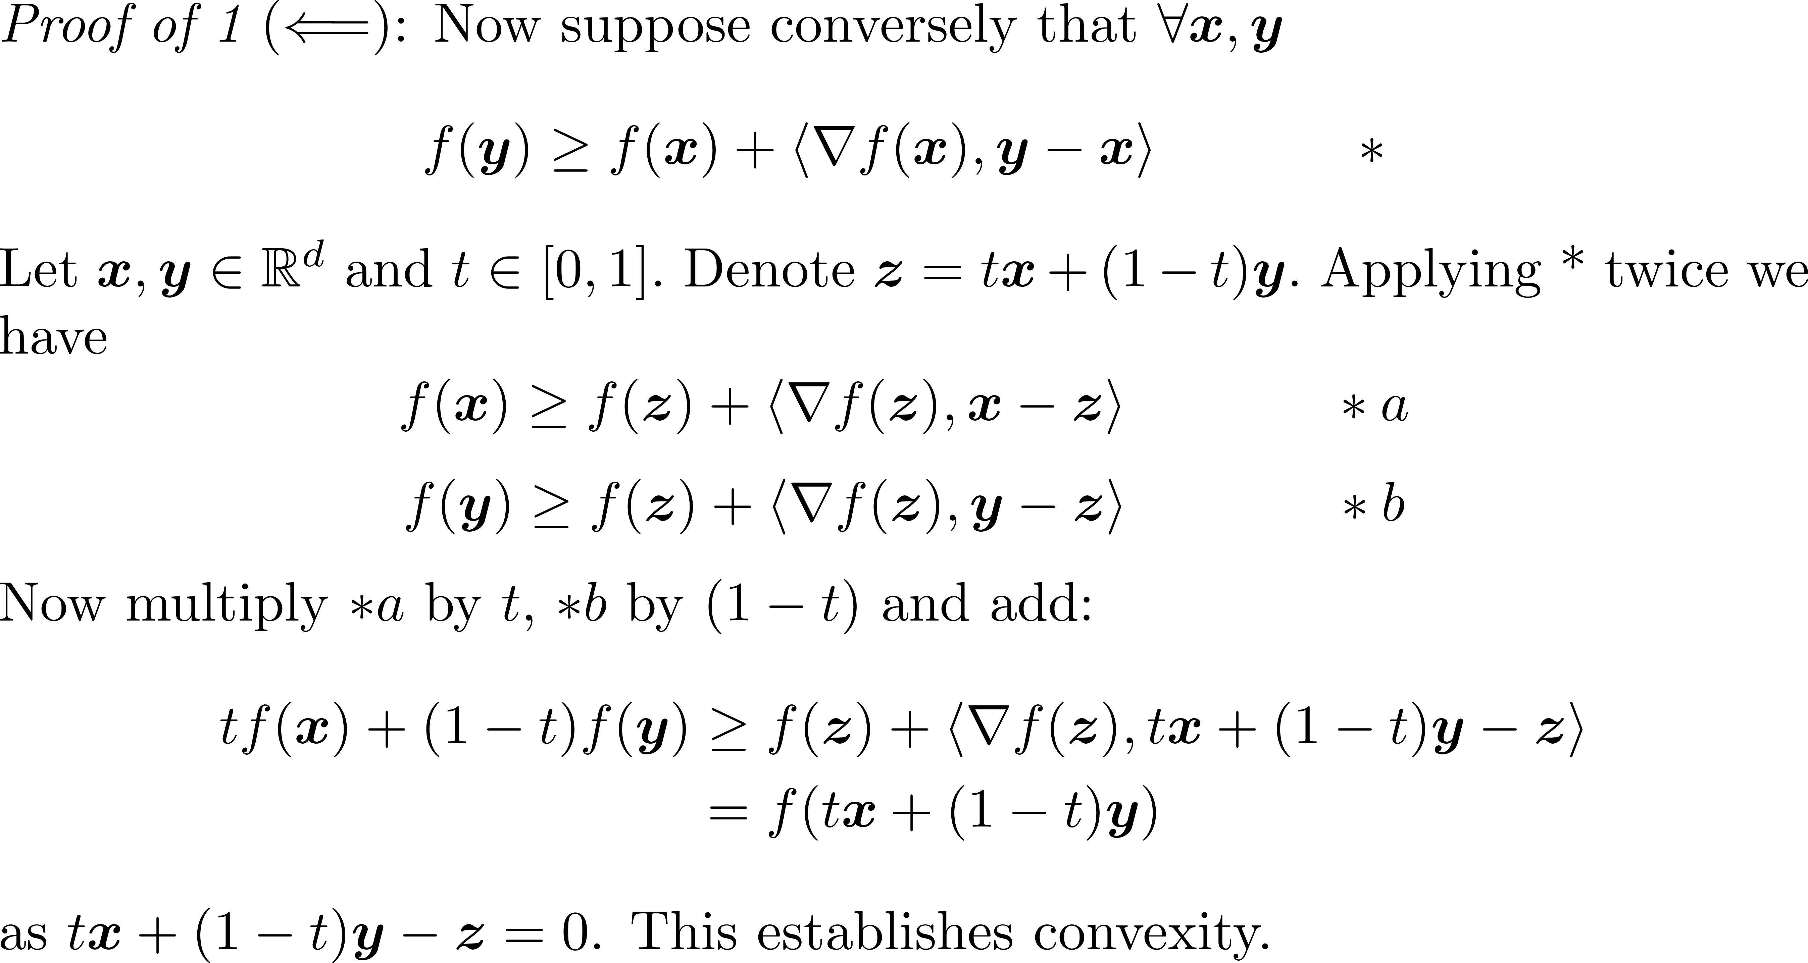
1st Order Characterization of Convexity

Slide 19
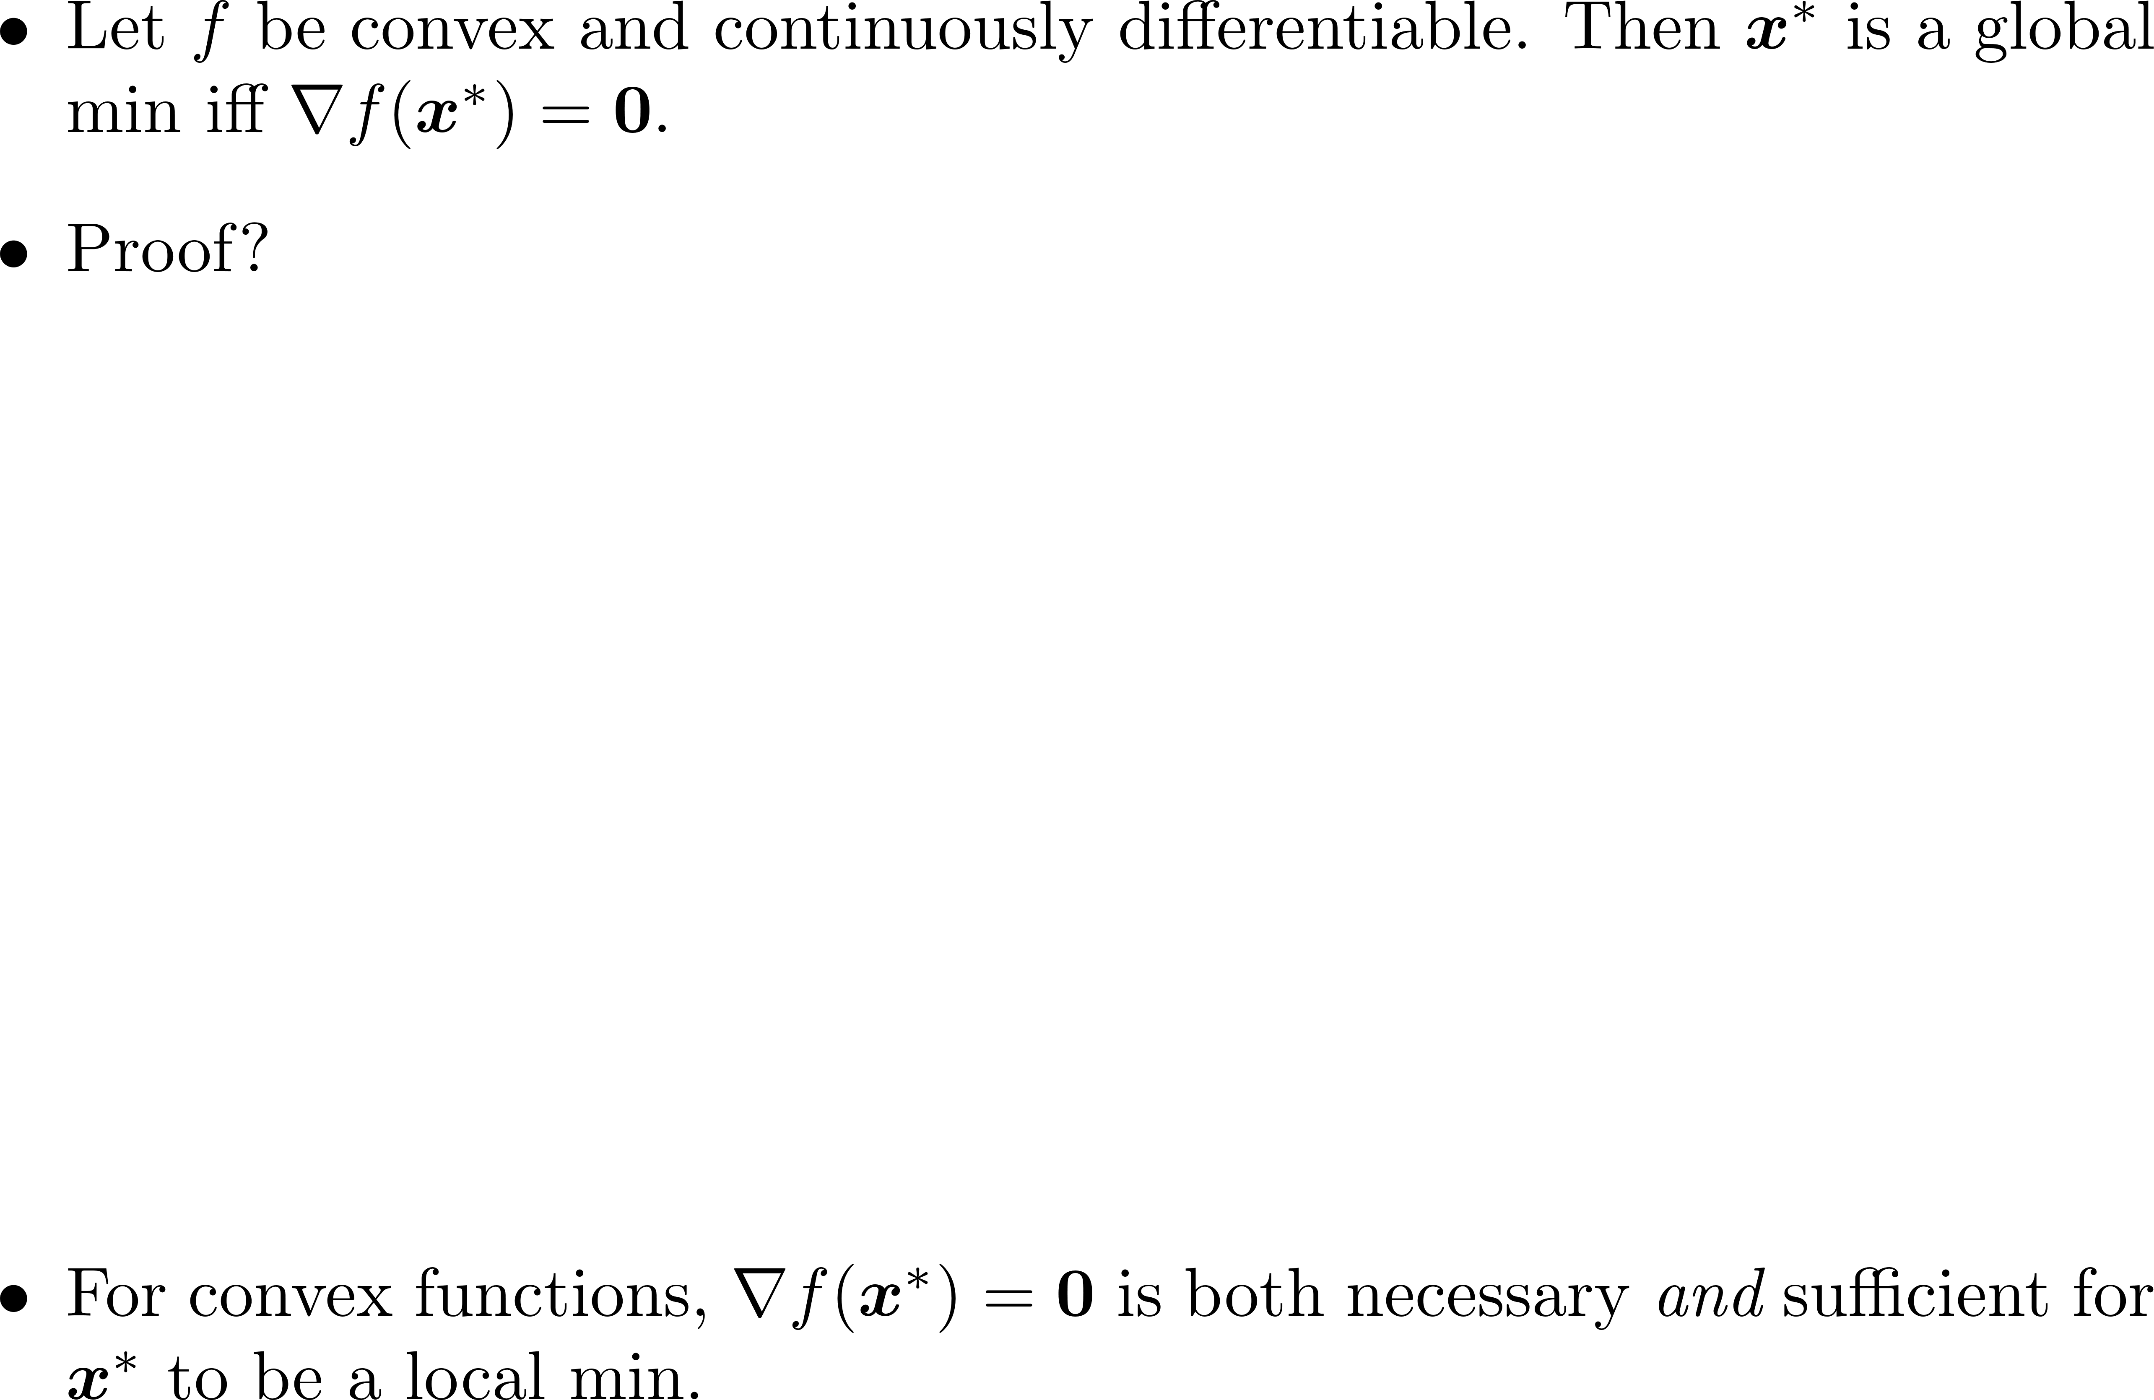
1st Order Condition for Local Min, Revisited

Slide 20
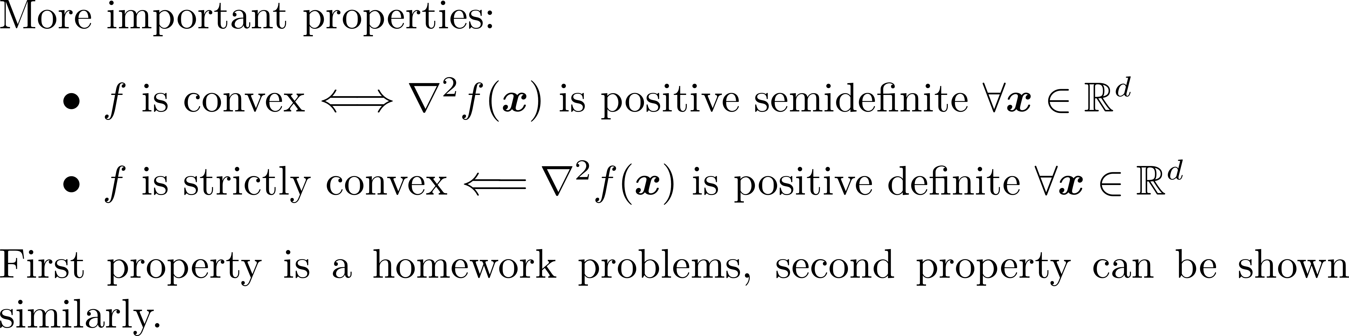
Second Order Conditions, Revisited

Slide 21
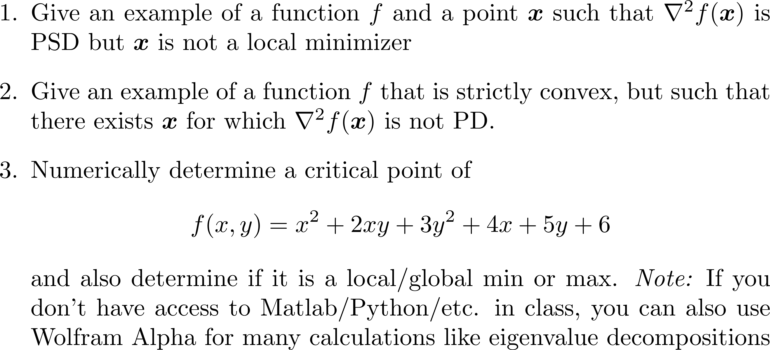
Group Exercise

Slide 22
Group Exercise Solution

